Slide 1
HACKTHON PROJECT –1 PrOJECT NAME: OTP Generator PROJECT.
HACKTHON -DEC-2021 ..
TeAM -2…
Thanks to our mentor :sanjeevan sir..

Slide 2

OTP number means it is consistes of four digits code..

Slide 3

ONE TIME Password (OTP)

Slide 4
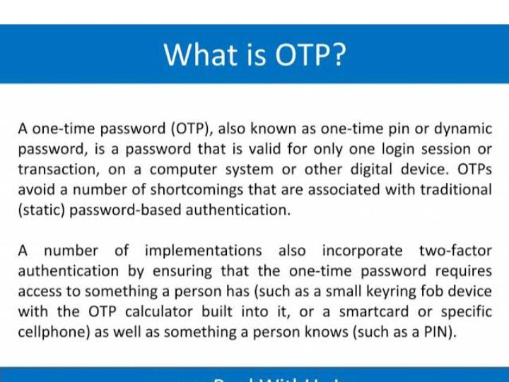
OTP MEANS:DEF

Slide 5
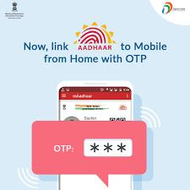
IT IS USED in aAdhaAr card PRODUCTION Also

Slide 6
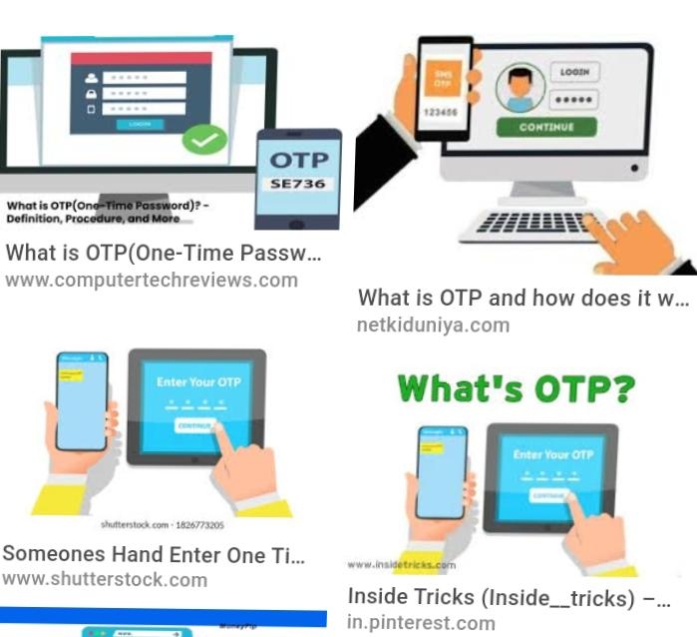
Uses of OTP

Slide 7


Slide 8
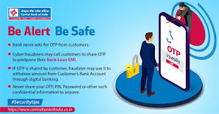
Be aLert,be safe and be aware with OTP

Slide 9
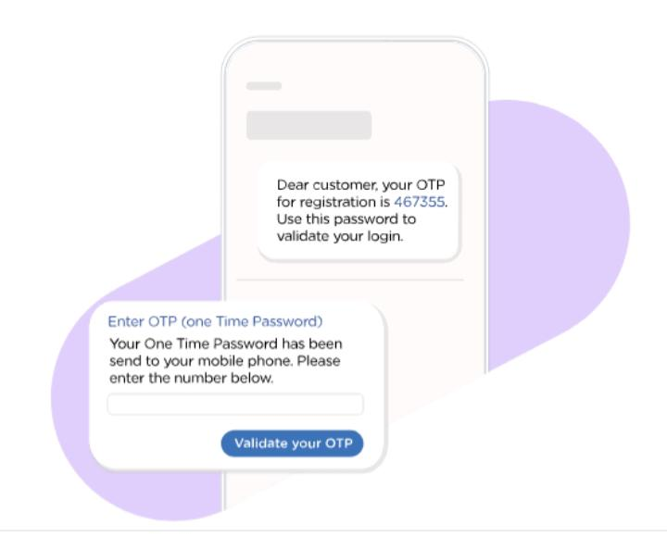
This the one of the example it is produced in your phone like this…

Slide 10
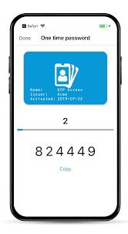
OTP means one time password so it has some time limit so used in within time and also it has 4 or 6 digts

Slide 11

This the explanation of about OTP…

Slide 12
HACKATHON- DECEMBER Project work-1
ROOM NO:B-203.
TEAM NO:2
TEAM LEADER:M.MARUTHI
TOTAL TEAM MEMBERS-6
1.K.HANUMAN SAI KISHORE
2.B.AKHILA
3.V.SRAVANI
4.M.SINDHU
5.K.S.M.L.S. VENKATA DURGA
6.M.MARUTHI
THANKS TO EVERYONE.👏

